Slide 1
Our Green City Hall

Slide 2
City Hall
The new City Hall is in the middle of getting a LEED certification!
LEED- Leadership in Energy & Environmental Design
LEED helped us to…
Create a healthier & more productive work & community meeting space
Design for efficient operating costs
Reduce waste sent to the landfill
Conserve natural resources

Slide 3
City Hall Roof
Since the roof is bright white, it reflects solar rays! This reduces the solar heat both outside and inside City Hall
Research selections at the Cool roof rating council when next installing new roofing at home or your business

Slide 4
Central Lake
A beautiful storm water detention system that is engineered to ensure storm water run-off meets quality standards and poses minimal potential for undesirable erosion and flooding down-stream

Slide 5
Rain Garden
You can install a rain garden as a landscape solution in a low lying area or near a roof downspout in your yard.
Our rain garden, similar to a “bioswale”, also helps to manage storm water on site.
These functional landscape features are specifically designed to capture, clean and absorb rain water run-off.
Notes:
Need to get a picture of the rain garden

Slide 6
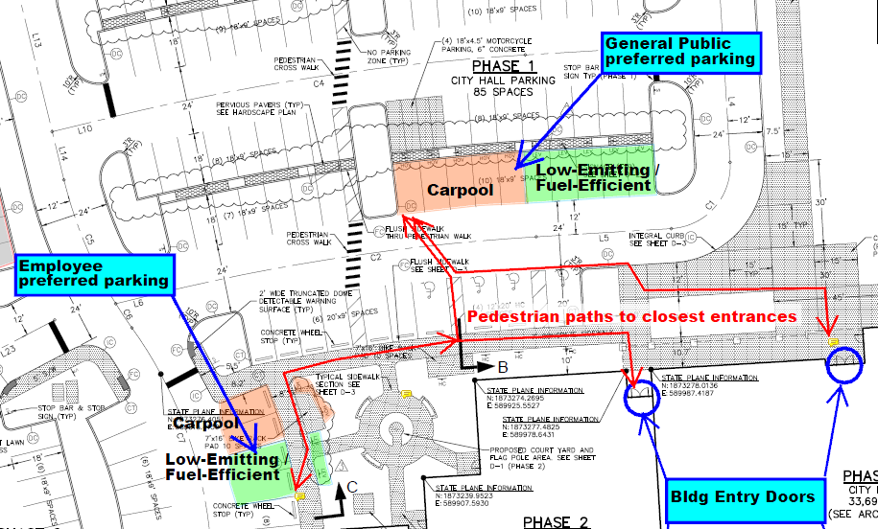
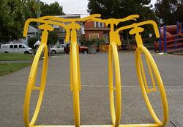
Alternative Transportation
In order to preserve as much of the site for community enjoyment as possible, we did not oversize the parking lot.
We are utilizing on-street parking to help meet the anticipated parking needs
Several bike racks are available
Reserved parking spaces are available for staff and visitors that carpool here
Several spaces are also reserved for qualifying “eco-preferred” vehicles

Slide 7
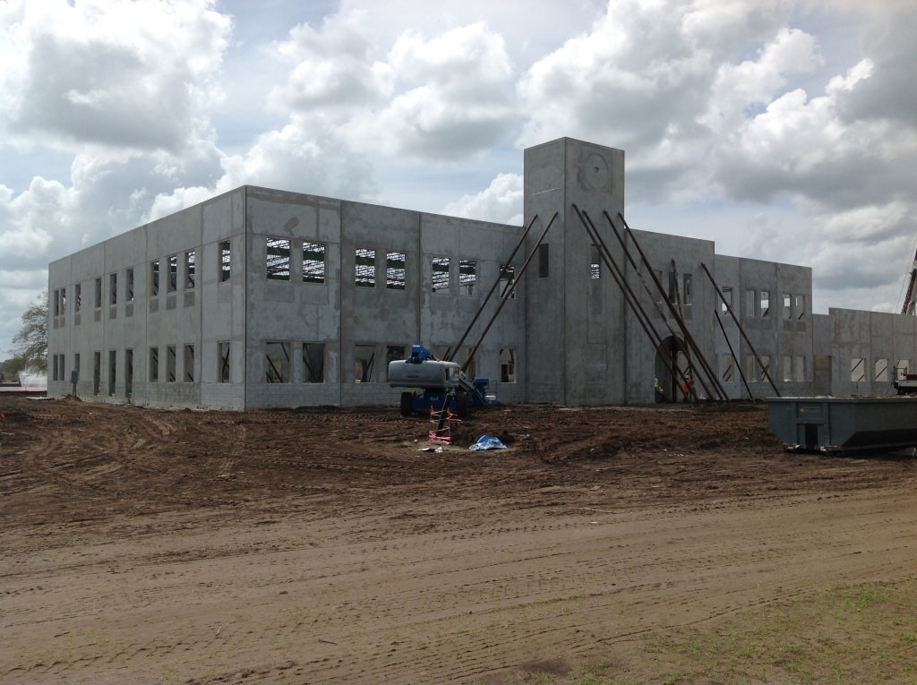
Construction
Responsible recycling ensured over 75% of the total waste resulting from our construction work was effectively diverted from the landfill
Conscientious construction material sourcing was conducted to use recycled and regionally based materials

Slide 8
Plumbing
In total, the City Hall plumbing fixtures use more than 40% less water than standard fixtures
Annual building operations will use at least 100,000 gallons less clean water than if standard fixtures had been installed
Choose WaterSense labeled plumbing fixtures to help conserve water in your own home or business

Slide 9
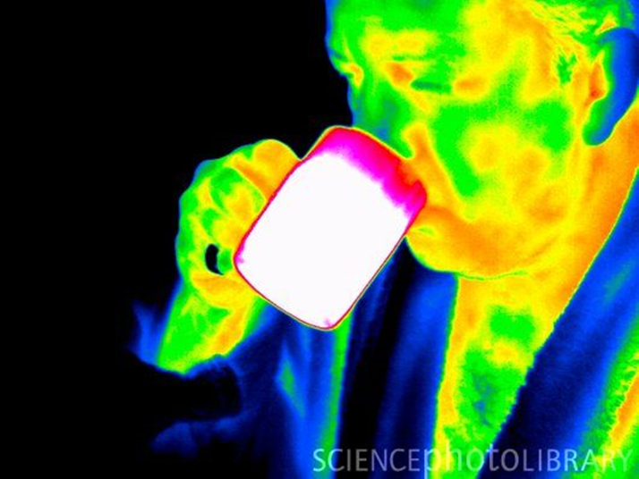
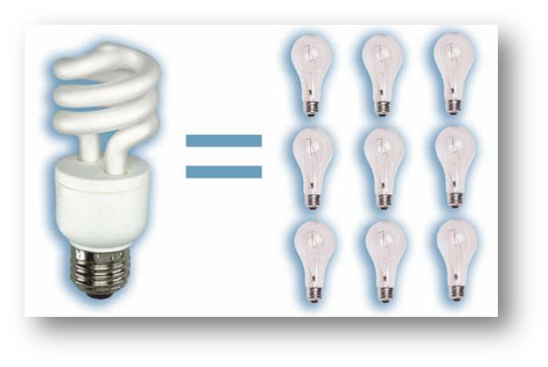
Lighting
Our light fixtures use high efficiency LED and fluorescent lamps (bulbs)
As a result, the total exterior & interior lighting design is 40% more energy efficient than required by code
Consider a higher efficiency option when replacing bulbs at home
The interior lighting uses ceiling and wall switch “smart” controls
Sensing movement and body heat, they automatically turn lights off to conserve energy in unoccupied rooms

Slide 10
Furniture
Safer “Low-VOC” products, which have lower airborne chemical release characteristics, were installed inside the building
This included the most critical products, such as adhesives, paints, flooring products, fabricated doors and built-in cabinetry
Minimizing the introduction of volatile organic compounds helped to reduce the “new building smell” as well as initial and long term adverse health impacts for the building occupants

Slide 11
Irrigation
Our landscape was specifically designed using beautiful Florida-friendly plant selections in conjunction with higher efficiency mister and drip irrigation wherever possible
Extremely heat and drought tolerant plants provide visual interest while reducing the amount of water required to maintain their health
In addition, the installed irrigation system relies exclusively on the City’s reclaimed water supply.
This strategy alone will conserve countless gallons of critical fresh water each year.
Notes:
Need to find picture for irrigation

Slide 12
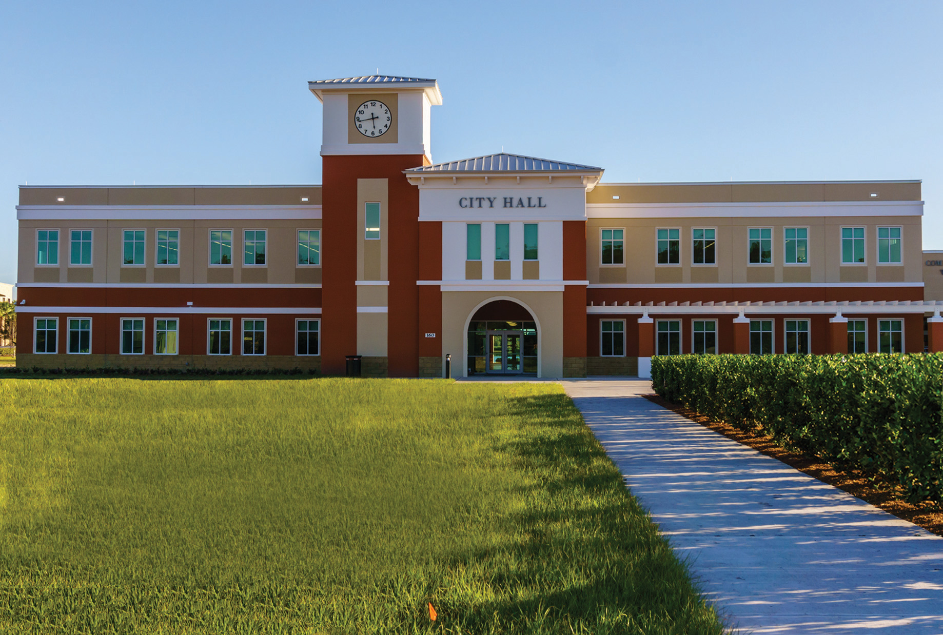
City Hall Tours
Can be customized to each group
Will last approximately 20-30 minutes
Will highlight the green attributes of City Hall
Go to www.?
Notes:
Find out official days and times when tours are available, find out website where people can request a tour

Slide 13
Thank You
Thank you for helping us keep Palm Coast green!
You can go to palmcoastgov.com/green to look for programs and initiatives you can participate in to be green
Every little thing you do to help the environment will make a difference
Notes:
Change link, to the new tab that will be created

