Slide 1
Annual Community Development Block Grant (CDBG) Program Applicant Workshop
January 20, 2017
Notes:
This is our annual workshop.

Slide 2
CDBG Entitlement Program Overview
Federal Program that started in1974 in order to provide community development and housing needs.
This component of CDBG helps qualified families and individuals with rehabilitation and repairs to correct health and safety code deficiencies.
Notes:
The CDBG program stands for Community Development Block Program. is mainly what we are talking about today. It is a Federal program established in 1974. The City receives funds and implements them through a coordinated program. This portion of the program is housing rehabilitation funds.

Slide 3
Commitment to Fair Housing
It is illegal to discriminate based on the race, color, religion, sex, National origin, age, disability, or familial status when renting, selling or financing a home or property.
You Have Rights!!
If you feel you have been discriminated against when purchasing or renting a home please contact:
Ida Meehan
Community Development Department
160 Lake Ave.
Palm Coast, FL 32164
Telephone: (386) 986-2482
Notes:
Reaffirm our commitment to fair housing as as part of the program. You have rights, you can call us.

Slide 4
Partnerships
Flagler County SHIP Office
Qualified Applicants
City of Palm Coast
Guardian Community Services
Housing and Urban Development
Licensed Contractors
Notes:
Partnerships……….

Slide 5
Participation Requirements
Basic Eligibility Requirements
Income Qualification Requirements
Notes:
There are some general requirements to participate and obtain housing rehabilitation assistance related to the home itself.

Slide 6
Basic Eligibility Requirements
Home must be a single family residence
Notes:
There are some general requirements to participate and obtain housing rehabilitation assistance.

Slide 7
Basic Eligibility Requirements
Home must be single family residence.
Home must be primary residence, be owner occupied.
Notes:
There are some general requirements to participate and obtain housing rehabilitation assistance.

Slide 8
Basic Eligibility Requirements
Home must be a single family home.
Home must be primary residence, be owner occupied.
Live at current residence one year prior to application.
Notes:
There are some general requirements to participate and obtain housing rehabilitation assistance.

Slide 9
Basic Eligibility Requirements
Home must be single family home.
Home must be primary residence, be owner occupied.
Live at current residence one year prior to application.
Homes must be located within incorporated City limits of the City of Palm Coast.
Notes:
There are some general requirements to participate and obtain housing rehabilitation assistance.

Slide 10
Basic Eligibility Requirements
Home must be a single family home.
Home must be primary residence, be owner occupied.
Live at current residence one year prior to application.
Homes must be located within incorporated City limits of the City of Palm Coast.
Homes must be free of all delinquent liens or debts, including but not limited to local utility and code infraction fines.
Notes:
There are some general requirements to participate and obtain housing rehabilitation assistance.

Slide 11
Income Qualification Requirements
Family or Individual must be income qualified by the County and fall within the current HUD FFY income allowable limits.
This is the work Val Bradley of Flagler County does for us.
Call Val on Monday to set an appointment!
Notes:
There is also the income qualification step. Start by filling out the application and gathering your secondary information.

Slide 12
FY 2016 – Income Limits
Assistance to households/buyers with incomes at or below 80% of the Area Median Income/AMI (LMI) (Very Low, Low to moderate income)
FY 2016 Income Limit Area | Median Income | FY 2016 Income Limit Category | Persons in Family
 |  |  | 1 | 2 | 3 | 4 | 5 | 6 | 7 | 8
Palm Coast, FL MSA | $52,200 | Low (80%) Income Limits ($) | $30,250 | $34,600 | $38,900 | $43,200 | $46,700 | $50,150 | $53,600 | $57,050
Notes:
This is the most recent income qualification requirements. The application focuses on these requirements. Val Bradley of Flagler County SHIP can answer specific questions on these requirements. Income by household members.

Slide 13
Eligible Rehabilitation Activities
Code Violations
Health & Safety
Disability Accessibility
General Property Improvements
Notes:
Very important these are the type of projects we are talking about. Generally these projects are oriented toward bringing houses up to building code and a decent and safe standard.

Slide 14
Eligible Rehabilitation Activities
Code Violations: Items which do not meet current housing codes. These include primary electrical services and wiring, plumbing and structural defects.
Notes:
Very important these are the type of projects we are talking about. Generally these projects are oriented toward bringing houses up to building code and a decent and safe standard. ELECTRICALSERVICES, WIRING, PLUMBING AND STRUCTURAL DEFECTS.

Slide 15
Eligible Rehabilitation Activities
Code Violations: Items which do not meet current housing codes. These include primary electrical services and wiring, plumbing and structural defects.
Health & Safety: Items which endanger health and safety such as roofing, bathroom fixtures, kitchen facilities and windows.
Notes:
ITEMS RELATED TO HEALTH AND SAFETY SUCH AS ROOFS, BATHROOMS FIXTURES, KITCHEN FACILITIES, AND WINDOWS.

Slide 16
Eligible Rehabilitation Activities
Code Violations: Items which do not meet current housing codes. These include primary electrical services and wiring, plumbing and structural defects.
Health & Safety: Items which endanger health and safety such as roofing, bathroom fixtures, kitchen facilities and windows.
Disability Accessibility: If you have a disability, ramps, grab bars and door widening may be included.
Notes:
PROGRAM STRONGLY ENCOURAGES APPLICATIONS FROM THOSE WITH A DISABILITY….IMPROVEMENTS OF THESE SORT INCLUDE RAMPS, GRAB BARS AND DOOR WIDENING.

Slide 17
Eligible Rehabilitation Activities
Code Violations: Items which do not meet current housing codes. These include primary electrical services and wiring, plumbing and structural defects.
Health & Safety: Items which endanger health and safety such as roofing, bathroom fixtures, kitchen facilities and windows.
Disability Accessibility: If you have a disability, ramps, grab bars and door widening may be included.
General Property Improvements: These are the items that make a house look nicer, feel more comfortable, and in some cases provide an increase in neighborhood morale. They include paint, carpet, vinyl, cabinets, etc. Funding for general improvements is limited and based on availability.
Notes:
GENERAL PROPERTY IMPROVEMENTS, IMPROVEMENTS THAT CAN MAKE THE HOUSE FEEL MORE COMFORTABLE AND NICERS, SUCH AS PAINT, CARPET, VINYL AND CABINENET

Slide 18
Obtaining a CDBG Application
Applications are available here at the workshop.
Applications can be picked up at the Palm Coast City Hall, Planning Division, during normal working hours Monday – Friday.
Applications are available online at www. Palmcoastgov.com.
Applications are available at the SHIP office on the third floor of the Flagler County Administration Building.
For questions on the application itself, contact Val Bradley at the SHIP office.

Slide 19
CDBG Application Completion
Applicant obtains and completes application and submits all secondary documentation requirements, including conflict of interest statement.
Completed application packages must be submitted - by appointment - to Val Bradley, SHIP office, Flagler County Administration Building, located at 1769 E. Moody Blvd., Bunnell, FL 32210. Call 386-313-4037.
Notes:
SO FIRST LOOK AT THE

Slide 20
CDBG Application Submittal
The deadline for receipt of completed applications is 4:00 pm on Friday February 17, 2017.
Applications will be time and date stamped to ensure compliance with the application period.
No applications will be accepted at COPC Offices.

Slide 21
Applicant Selection & Funding
Applications will be considered on a first come, first qualified, first serve basis, consistent with the City’s Housing Assistant Plan (HAP).
Funds will be committed on a first qualified, first serve basis.
If qualified, the applicant receives eligibility letter once fully income qualified.
If necessary, a waiting list may be established for the next cycle.

Slide 22
Pre-Bid Steps
Title search completed on property to determine ownership, and lien status.
Inspection performed on property to determine rehabilitation needs and cost feasibility.
Work write-up & Scope of Work completed for CDBG program.
Notes:
Everyone that income qualifies will have their house inspected .

Slide 23
Pre-Bid Steps
May include lead based paint and asbestos testing performed (if required) to assist in property qualification.
Final review of applicant and property qualifications performed.

Slide 24
City BID Process
After application and property review, the housing unit will be submitted for bid to a City qualified pool of contractors.
A pre-bid meeting (at a scheduled date and time) will be conducted for each property eligible for bid and rehabilitation.
Contractors will participate in a City/Guardian guided walkthrough of each property.

Slide 25
City BID Process
Bids that are submitted will be opened in a City supervised setting.
Bids will be reviewed for accuracy and tabulated.
Award recommendations will be made based on the lowest responsible bid in accordance with HAP guidelines.

Slide 26
BID Awards & Contract Signing
Once bids are approved, they are available for owner review and contractor selection.
After bid review and contractor selection, a contract and mortgage signing date and time will be scheduled with the homeowner.
Next the Contract, Mortgage and Note documents are signed.
Also the Notice to Proceed and Notice of Commencement are signed and notarized.
The three day rescission form is also signed.

Slide 27
Construction and Payment
Construction length: Generally 45 days for rehab, 120 days for replacement.
Contractor payments must be signed and approved by homeowner, Guardian and City representatives.
All work will have a 1 year Contractor to Owner warranty (5 year for roof) for all workmanship and new materials used, plus any manufactures warranties as applicable.
A homeowner may be asked to move out in the case of extreme rehabilitation or replacement. Temporary relocation assistance may be available.

Slide 28
CDBG FAQS
How much do I have to pay?
You will sign a deferred payment loan (DPL) agreement which states if you sell the property within five or ten years, depending on the level of assistance, you will be obligated to pay back a portion of the “loan.”
Therefore, you do not have to pay any money for the work -- with the exception of FEMA awards or Homeowners Insurance (loss of dwelling).

Slide 29
CDBG FAQS
Do I have any input about the work?
You are encouraged to check the work as it is being done to assure that it is being done correctly. The scope of work, however, is determined by program guidelines.

Slide 30
CDBG FAQS
What if I want additional work done?
If you want additional items such as general property improvements or an addition that you are willing to pay for, it will be required that you wait until the CDBG repairs and contract are complete.
You at that time may procure the services of the contracting firm working on your home or other such firms to complete any additional work wanted at your expense. Any additional work will not be City responsibility and will not be covered by the CDBG warranty.

Slide 31
CDBG FAQS
Do I have to move out when the work is being done?
In some cases, the answer may be yes … The type of work, at times, may make it difficult for you to occupy the house while the work is in progress. Exceptions may be made if the amount of work is limited.

Slide 32
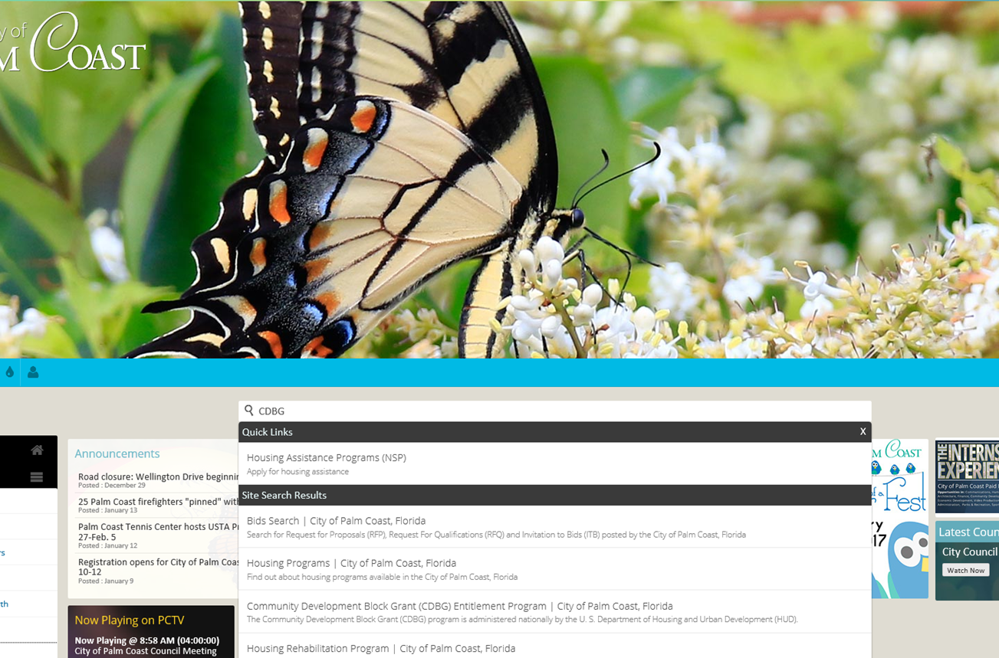
City Website is a Housing Resource – www.palmcoastgov.com

Slide 33
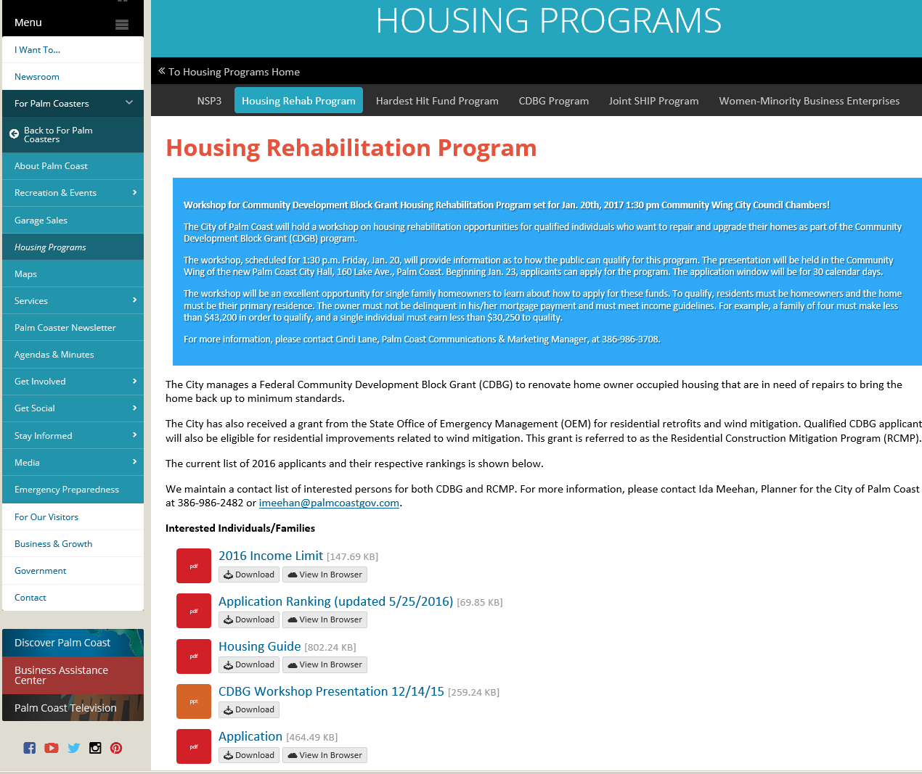
CDBG WEB PAGE @ www.palmcoastgov.com

Slide 34
CDBG Program – Summary of Key Points
Basic Eligibility Requirements
Income Requirements
Deferred Mortgage Lien
If you are interested, please call Monday to make appointments with Val Bradley. Call her 386-313-4037.
Four week application window.
No applications will be accepted at City offices.

Slide 35
Other Resources
If I have a question or problem, whom do I call?
Question | Contact | Phone
CDBG Program | Ida Meehan, City of Palm Coast | 386-986-2482
Income Qualification/Application requirements for submittal | Val Bradley, SHIP, Flagler County | 386-313-4037
Construction Contract Oversight | Antonio Jenkins, Guardian Community Services | 1-888-482-7393

Slide 36
THANK YOU
Questions?

